Slide 1

Parallel Programming SS21 Final Project
Project 1: Graph Convolutional Neural Networks
Group 119
14.07.2021
Batuhan Erden

Slide 2
Outline
Sequential code analysis
Improved sequential code analysis
OpenMP
Message Passing Interface (MPI)
Hybrid (OpenMP + MPI)
Bonus
Conclusion

Slide 3
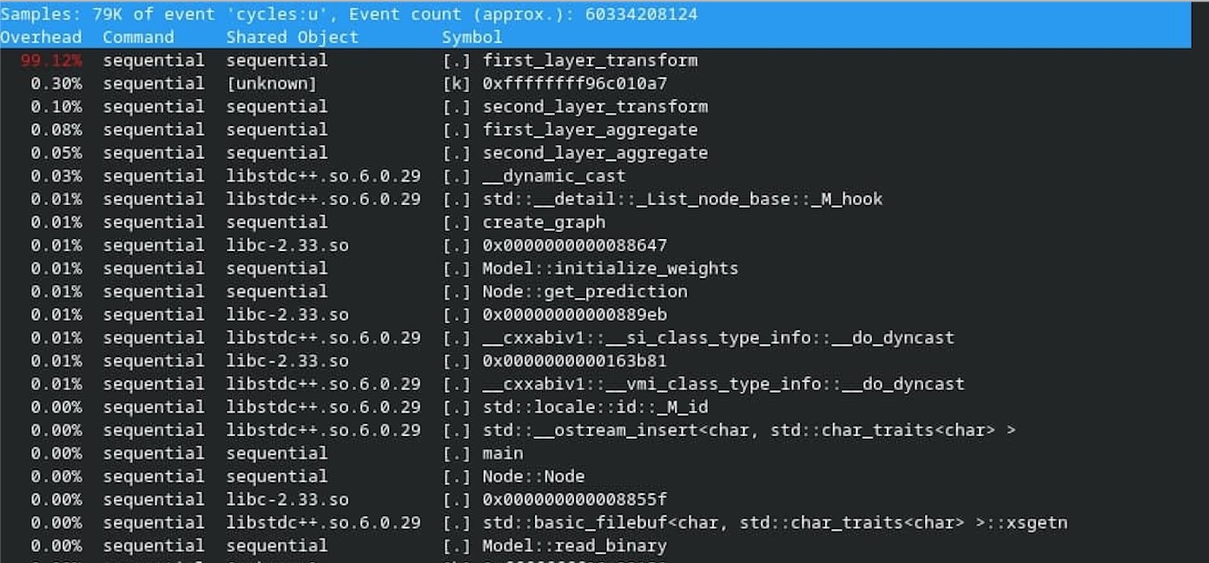
Sequential code analysis - Profiling
Perf results (79K samples):

Slide 4
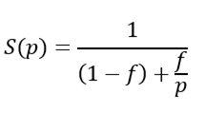
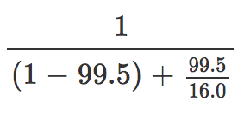
Sequential code analysis - Amdahl‘s law
f = fraction of parallel execution
p = number of parallel tasks/threads/processes
From the output of perf in the previous slide, we can deduce that 99.5% of the code is parallelizable. As we have 16 cores on the server, we can apply the formula:
As can be seen from the calculation above, with no improvements on the sequential code, we should get a maximum speedup of 14.88x from the parallelization.
However, this is barely above the minimum passing threshold. It was an imperative thing to improve the sequential code before the parallelization to get a good speedup.

Slide 5
Outline
Sequential code analysis
Improved sequential code analysis
OpenMP
Message Passing Interface (MPI)
Hybrid (OpenMP + MPI)
Bonus
Conclusion

Slide 6
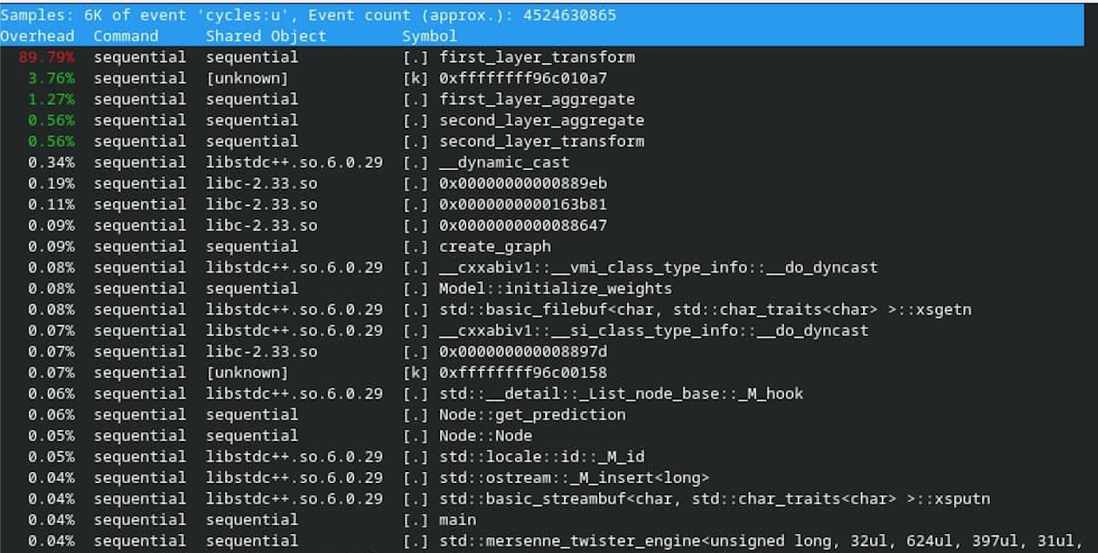
Improved sequential code analysis - Profiling
Perf results (6K samples):

Slide 7
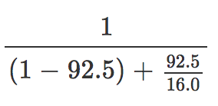
Improved sequential code analysis - Amdahl‘s law
f = fraction of parallel execution
p = number of parallel tasks/threads/processes
From the output of perf in the previous slide, we can deduce that 92.5% of the code is parallelizable. As we have 16 cores on the server, we can apply the formula:
As can be seen from the calculation above, with no improvements on the sequential code, we should get a maximum speedup of 7.53x from the parallelization.
Just the improved version of the sequential code gets a speedup of 7x. So, in the end, according to the Amdahl’s law, we should get a speedup of 7.53x * 7x ≈ 53x.

Slide 8
Outline
Sequential code analysis
Improved sequential code analysis
OpenMP
Message Passing Interface (MPI)
Hybrid (OpenMP + MPI)
Bonus
Conclusion

Slide 9
OpenMP - Parallelized implementation and approach
Parallelization of the outermost loops (starting with the one in first_layer_transform) with a simple #pragma omp parallel for.
Tried to play with the omp calls and added a schedule to #pragma omp parallel for.
Neither static nor dynamic scheduling did not seem to help with the speedup.
Playing with the number of threads made it even worse in terms of our speedup.
Completed the parallelization by using tasks and parallelized the body block of the outermost for loop in first_layer_transform.
Since tasks will be created on request, I thought that this might be better to use.
However, the speedup was around the same with just #pragma omp parallel for.
Also tried tasks in the other functions, but it only made things worse.
Creates overhead since all those functions must wait for each other before starting their computations with omp taskwait.
Observed a small speedup by parallelizing the outermost loop in all of these functions by #pragma omp parallel for without specifying any schedule or number of threads.

Slide 10
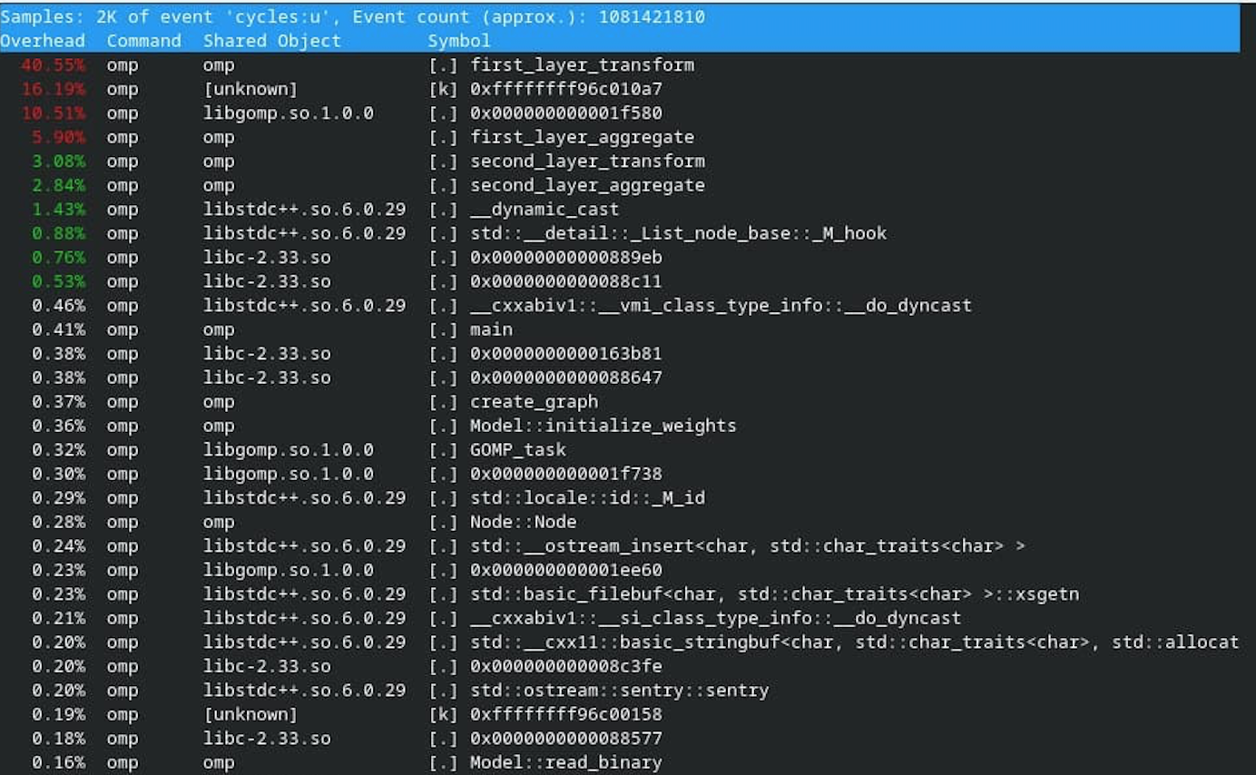
OpenMP - Intermediate Speed-up results, profiling
This implementation gets a speedup around 25x.
Perf results (2K samples):

Slide 11
OpenMP - Final Implementation improvements and new speed-up
Also parallelized the other for loops (in the main and create_graph functions) also with #pragma omp parallel for and each of those gave a small speedup to the problem.
Set the number of threads of omp by omp_set_num_threads.
Tested some values on the Submission Server, and found a sweet spot when the number of threads is set to 16, and in doing so, this gave us speedup of 50-52.5x.
Amdahl’s law: 7.53x * 7x ≈ 53x.
The speedup I got: 50-52.5x.

Slide 12
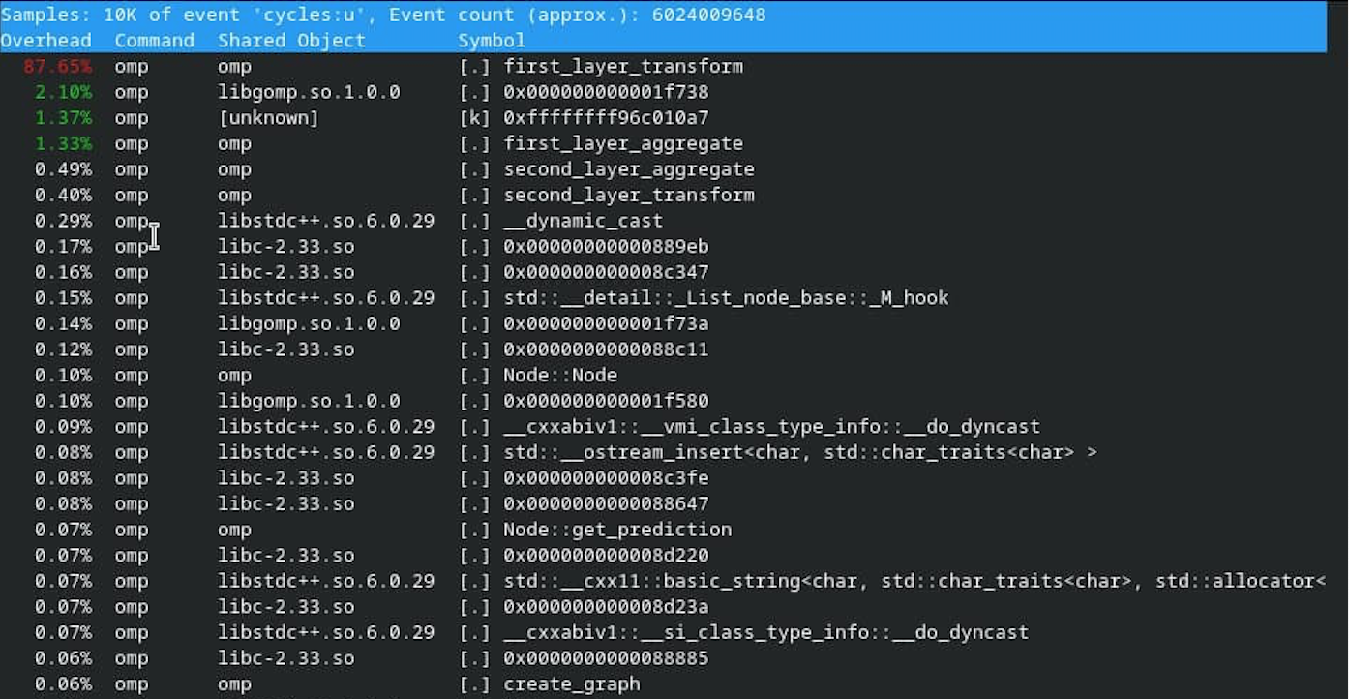
OpenMP - Final Implementation improvements and new speed-up
Perf results (10K samples):

Slide 13
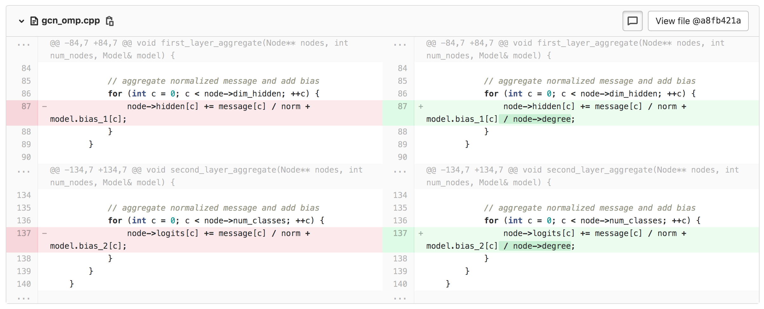
OpenMP - Errors found after the submission
The data that we were working with in the OpenMP submission was faulty. My submission was working with it, but when I tried it after the deadline, it didn’t work because the faulty data was corrected after the submission deadline.
How I fixed the error (If the data was correct at that time, it’d have taken me less than 2 minutes to solve it):

Slide 14
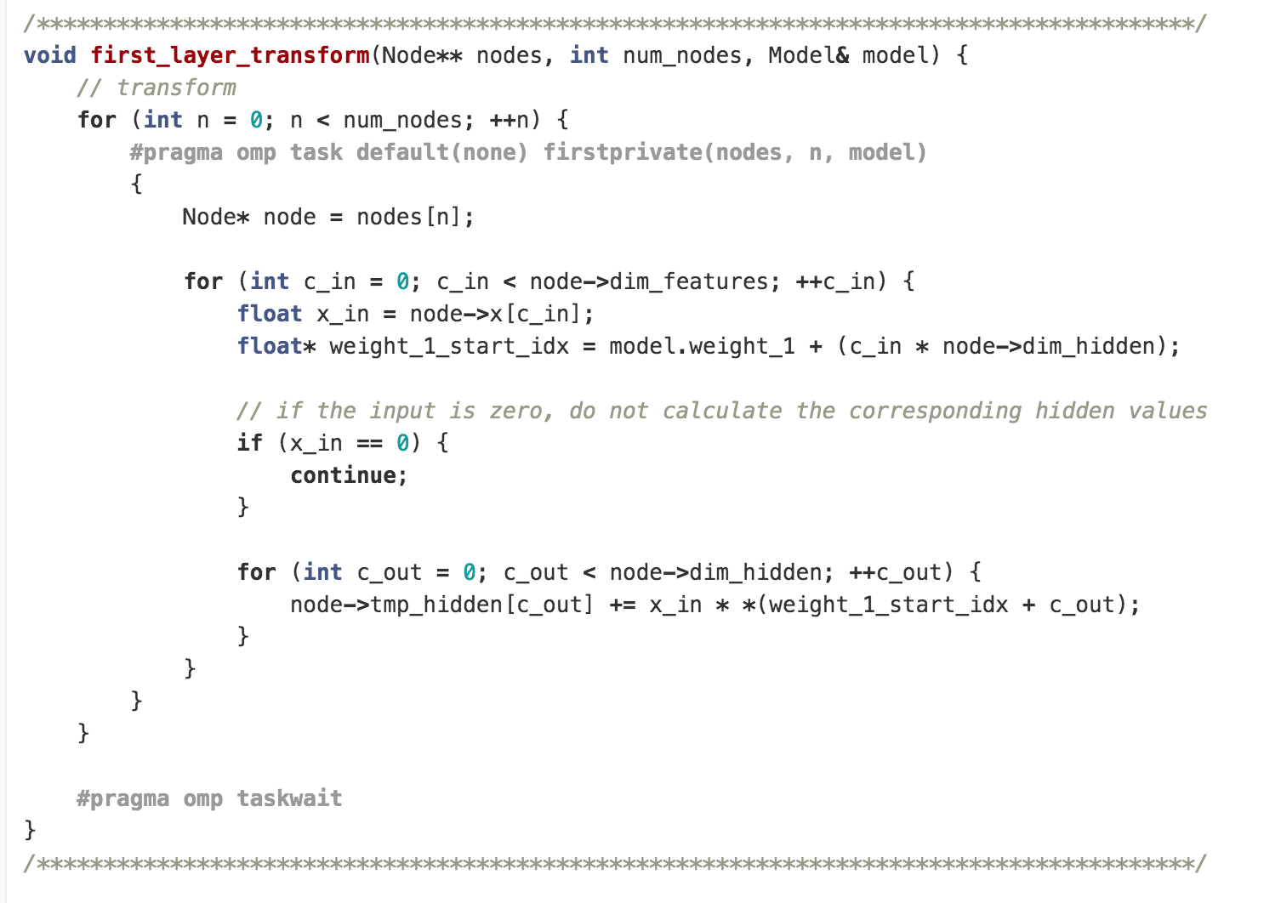
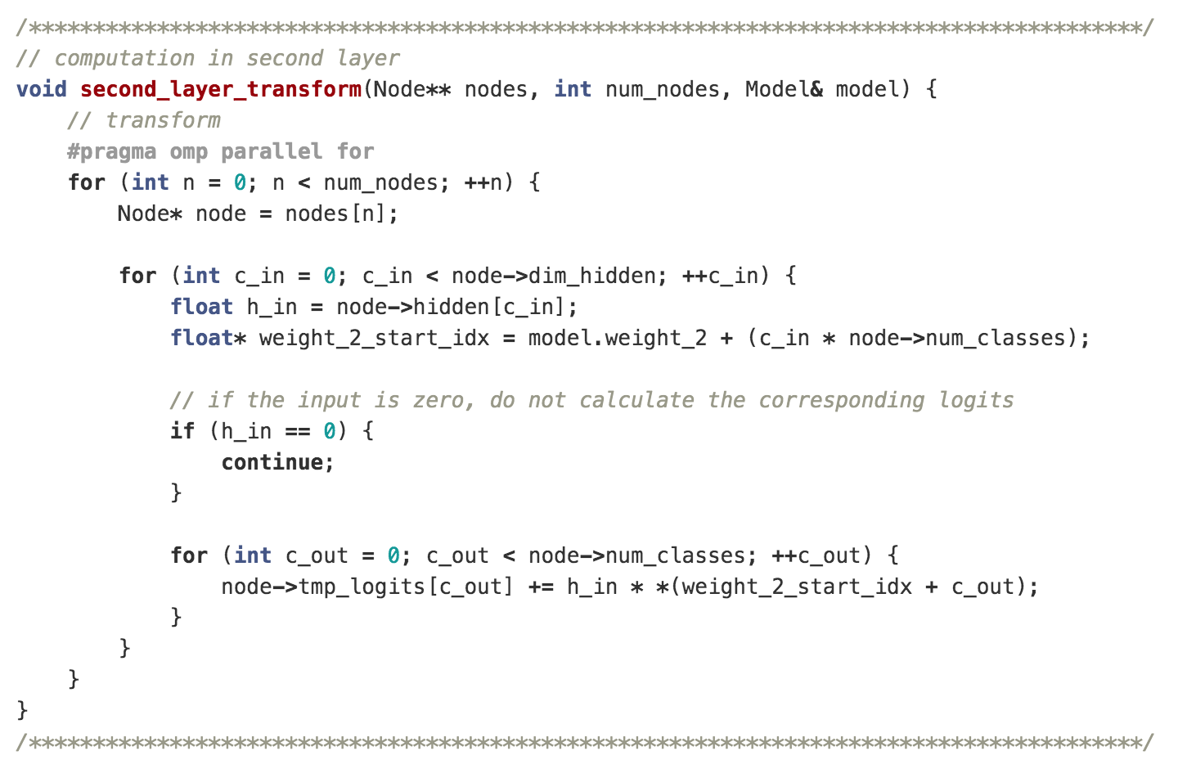
OpenMP - Further improvements
Working with the next MPI submission, I found out another improvement to the code.
With this change, I saw an enormous speedup of 90x.

Slide 15
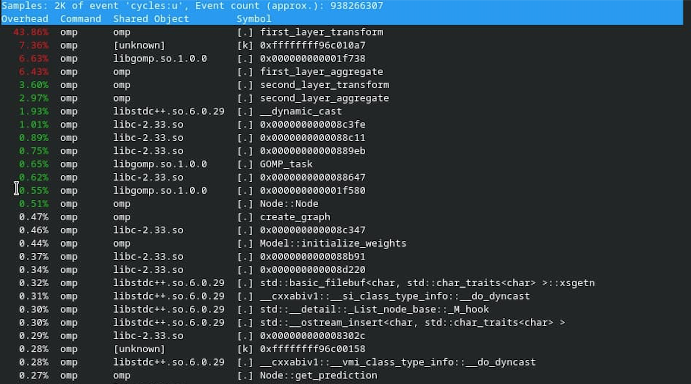
OpenMP - Further improvements
Perf results (2K samples):

Slide 16
Outline
Sequential code analysis
Improved sequential code analysis
OpenMP
Message Passing Interface (MPI)
Hybrid (OpenMP + MPI)
Bonus
Conclusion

Slide 17
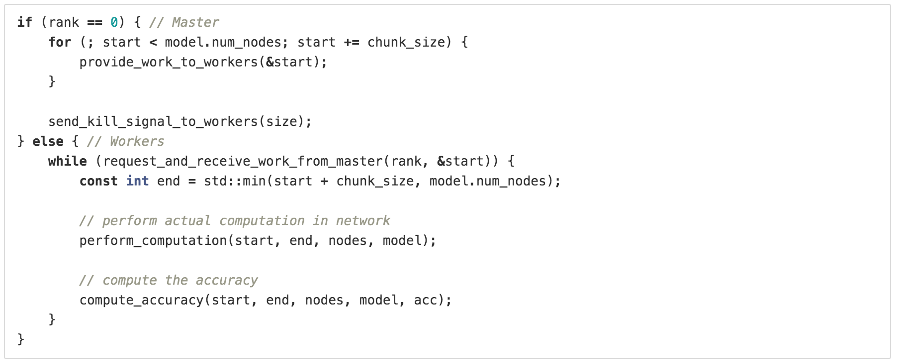
MPI - Parallelized implementation and approach
Implementing a basic MPI framework would give me a speedup of 7x.
I tried to investigate the data a bit and saw that the neighbours were not uniformly distributed and the first chunk would process 4-5 times more neighbours than the others. So, I thought I could try Dynamic Scheduling:

Slide 18
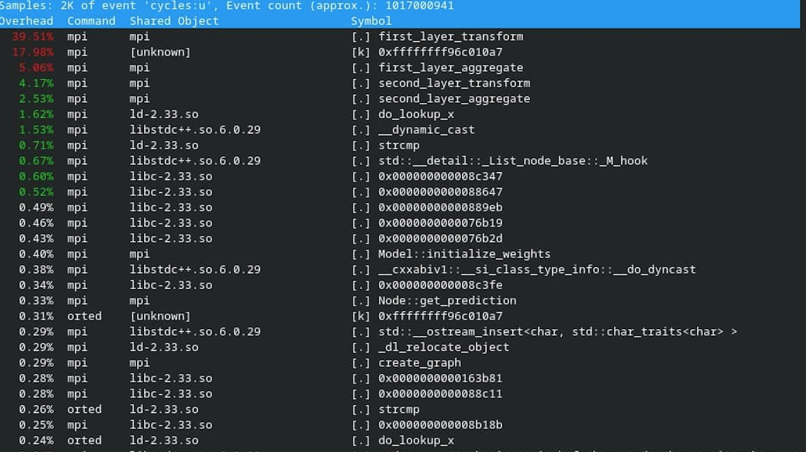
MPI - Intermediate Speed-up results, profiling
The dynamic scheduling approach gave me a speedup of 15x.
Perf results (2K samples):

Slide 19
MPI - Intermediate Speed-up results, profiling
Tried the optimization described in the final OpenMP slide also in this submission, and this got me a speedup around 28x.
I was happy to have the 1st place in the leaderboard.
However, I did not know something important!

Slide 20
MPI - Final Implementation improvements and new speed-up
There were 2 important points (I fixed them in the end!):
I had missed the statement in the PDF stating that the input files may only be found on RANK 0, i.e. we may only read files on RANK 0.
The dataset we were given was faulty and it got fixed. So, our implementation wasn't working anymore and there must have been a mistake.
Handled these 2 points above and barely passed the speedup threshold.
First made sure that only the master would read the files.
Making only this change dropped our speedup by a great margin to 12x.
Reinvestigated the dataset to find out that now the neighbors are more uniformly distributed.
Got rid of my Dynamic Scheduling approach.
Wanted to have a clearer approach and tried working with Gathers and Scatters, and came up with a solution using those (I omitted using Scatters in the end).
At this point, the speedup I was getting was 19x.

Slide 21
MPI - Final Implementation improvements and new speed-up
Some final changes that improved the speedup to 23x:
At first, only the master was doing the aggregate and accuracy computation operations. It was because I wanted to keep the communication overhead as small as possible.
But we have the same overhead when broadcasting the output of first layer transform instead of the output of first layer aggregate!
So, I did that and parallelized also first layer aggregate. Also did the same thing to second layer aggregate and accuracy computation operations because I wanted to have consistency. As this did not decrease our speedup, and I think it gave it a small jump, I decided to keep it.
Amdahl’s law: 7.53x * 7x ≈ 53x.
The speedup I got: 23x.

Slide 22
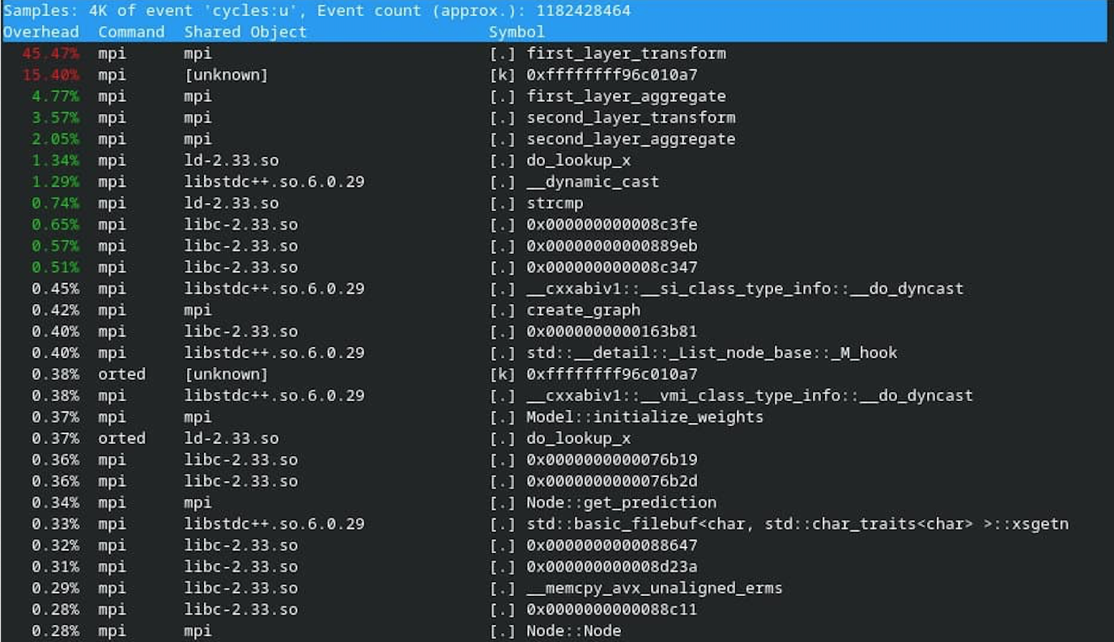
MPI - Final Implementation improvements and new speed-up
Perf results (4K samples):

Slide 23
Outline
Sequential code analysis
Improved sequential code analysis
OpenMP
Message Passing Interface (MPI)
Hybrid (OpenMP + MPI)
Bonus
Conclusion

Slide 24
Hybrid - Parallelized implementation and approach
I already had tried lots of things trying to improve my OpenMP and MPI submissions.
My solution is basically the combination of our MPI and OpenMP implementations. I build my OpenMP parallelization on my MPI implementation and tried to make use of the shared memory of each compute node in themselves.

Slide 25
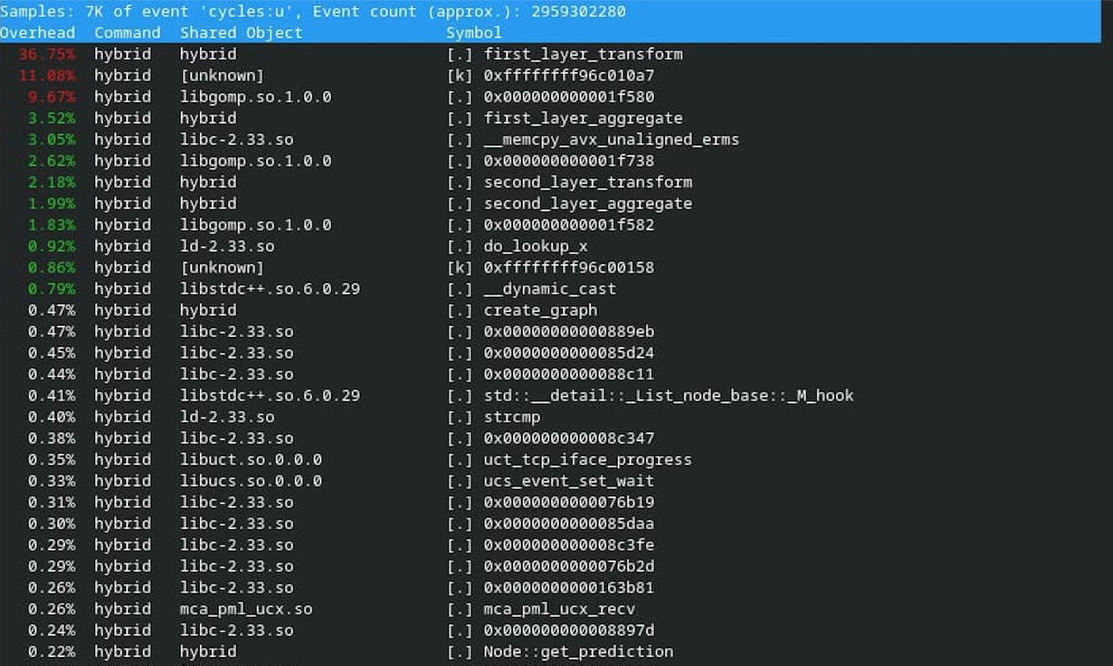
Hybrid - Intermediate Speed-up results, profiling
Successfully building this framework gave me a speedup of 40x.
Perf results (7K samples):

Slide 26
Hybrid - Final Performance Results
Changed the scheduling of the OMP parallel calls to Dynamic Scheduling because:
In the transform functions, some nodes can have more 0s in their inputs!
In the aggregation functions, neighbors might not be uniformly distributed across the nodes!
The Dynamic Scheduling here gave me a speedup of 44x.
Amdahl’s law: 7.53x * 7x ≈ 53x.
The speedup I got: 44x.

Slide 27
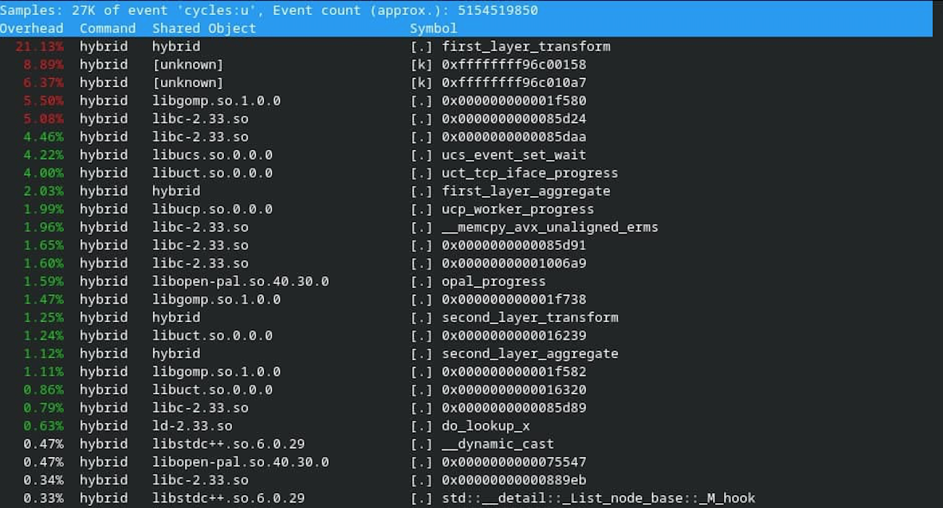
Hybrid - Final Performance Results
Perf results (27K samples):

Slide 28
Hybrid - Further improvements
Achieved a speedup of 76x (0.27244s) and secured the 1st place in the leaderboard!
Decreased the communication overhead by delegating the first layer transform operation only to the master.
Delegating the first layer transform operation only to the master, and then have the master broadcast the output of the first layer transform operation (big_tmp_hidden - tmp_hidden for the full graph) to the other processes, I decreased the communication overhead caused by communicating the X values and achieve a speedup of 76x.
However, I decided not to use this solution here and used it in the bonus submission instead!

Slide 29
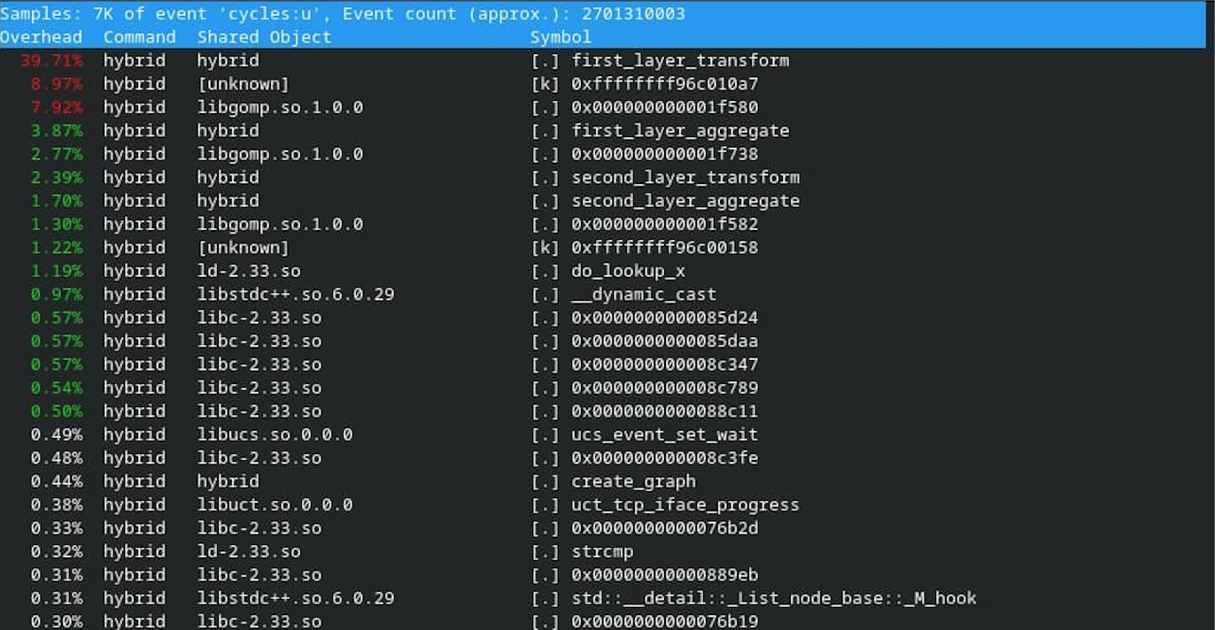
Hybrid - Further improvements
Perf results (7K samples):

Slide 30
Outline
Sequential code analysis
Improved sequential code analysis
OpenMP
Message Passing Interface (MPI)
Hybrid (OpenMP + MPI)
Bonus
Conclusion

Slide 31
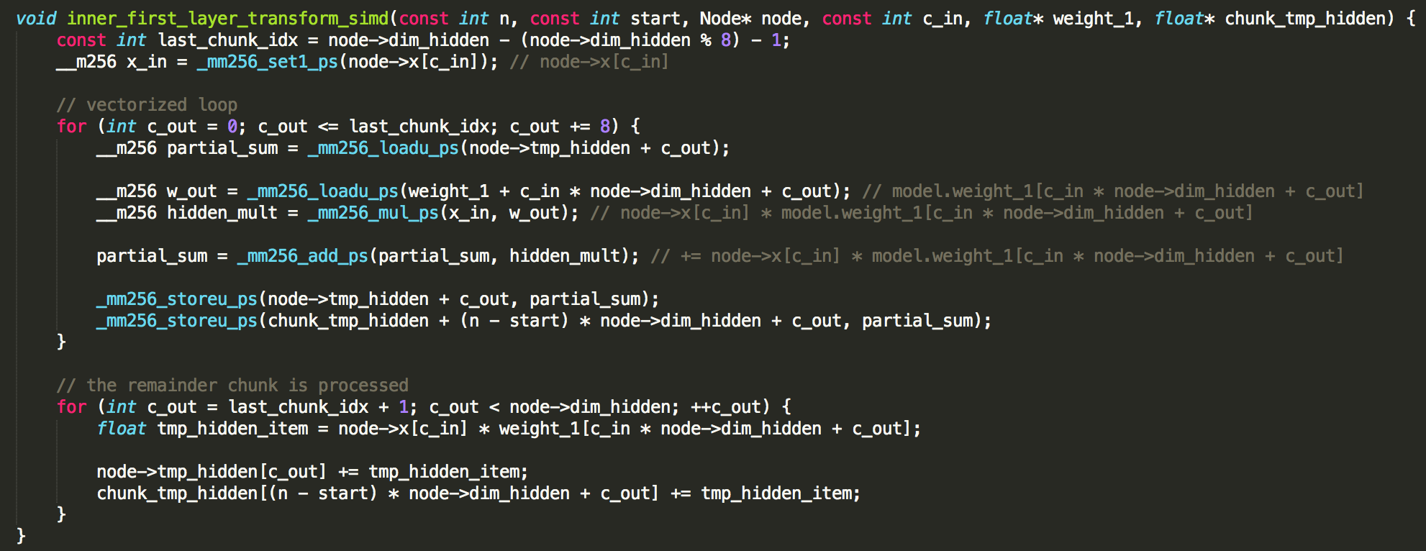
Bonus - Parallelized implementation and approach
Decrease the communication overhead and apply SIMD on top of the Hybrid implementation!

Slide 32
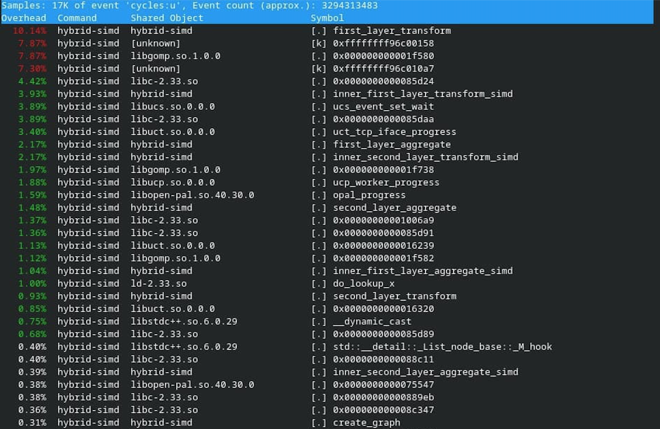
Bonus - Final Performance Results
The final speedup achieved is 44x.
Perf results (17K samples):

Slide 33
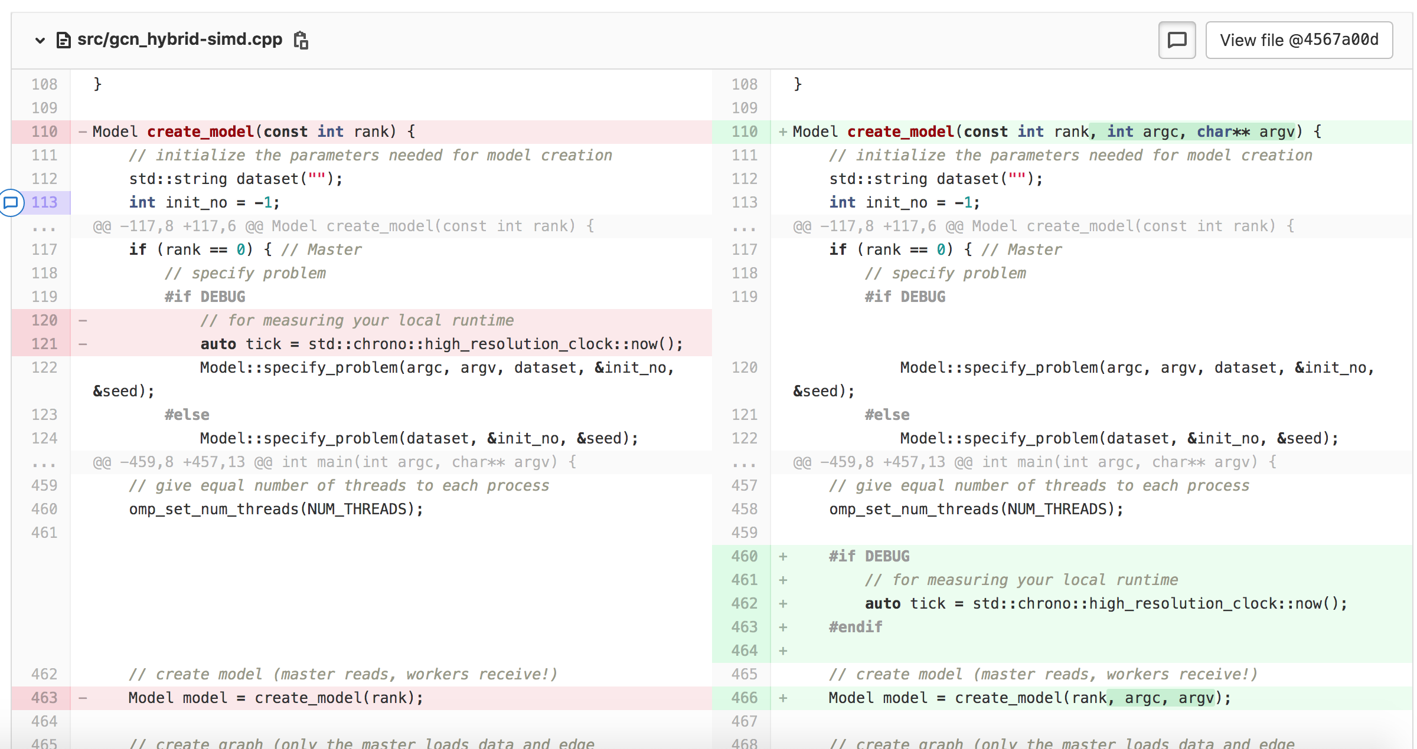
Why the code cannot be run with DEBUG = 1
The changes that need to be made to fix this issue:
This issue is related to MPI, Hybrid and Bonus submissions!

Slide 34
Outline
Sequential code analysis
Improved sequential code analysis
OpenMP
Message Passing Interface (MPI)
Hybrid (OpenMP + MPI)
Bonus
Conclusion

Slide 35
Conclusion
OMP gives a speedup almost identical to the Amdahl‘s law: 50-52.5x. With the further improvements to the code, it‘s possible to get a speedup of 90x.
MPI decreases the speedup. However, we are testing this with a single compute node. We would see the benefits on a real cluster of different compute nodes. Still, the communication overhead is a problem that must be addressed. The speedup achieved is 23x. With the further improvements, it is possible to achieve a higher speedup of 28x.
With the Hybrid implementation, I gained some speedup by making use of the shared memory of each compute node in themselves: 44x. Decreasing the communication overhead, a speedup of 75x could be achieved!
Applying SIMD actually decreases the speedup to 20x. However, we compensated this by decreasing the communication overhead! The final speedup achieved is 44x.

Slide 36
Q & A
Should you have any questions, please do not hesitate to ask ☺

